Slide 1
A little introduction to SQL Server Big Data Clusters
……………………………………………………………………………………………….
Enrico van de Laar – Data Saturday Holland

Slide 2








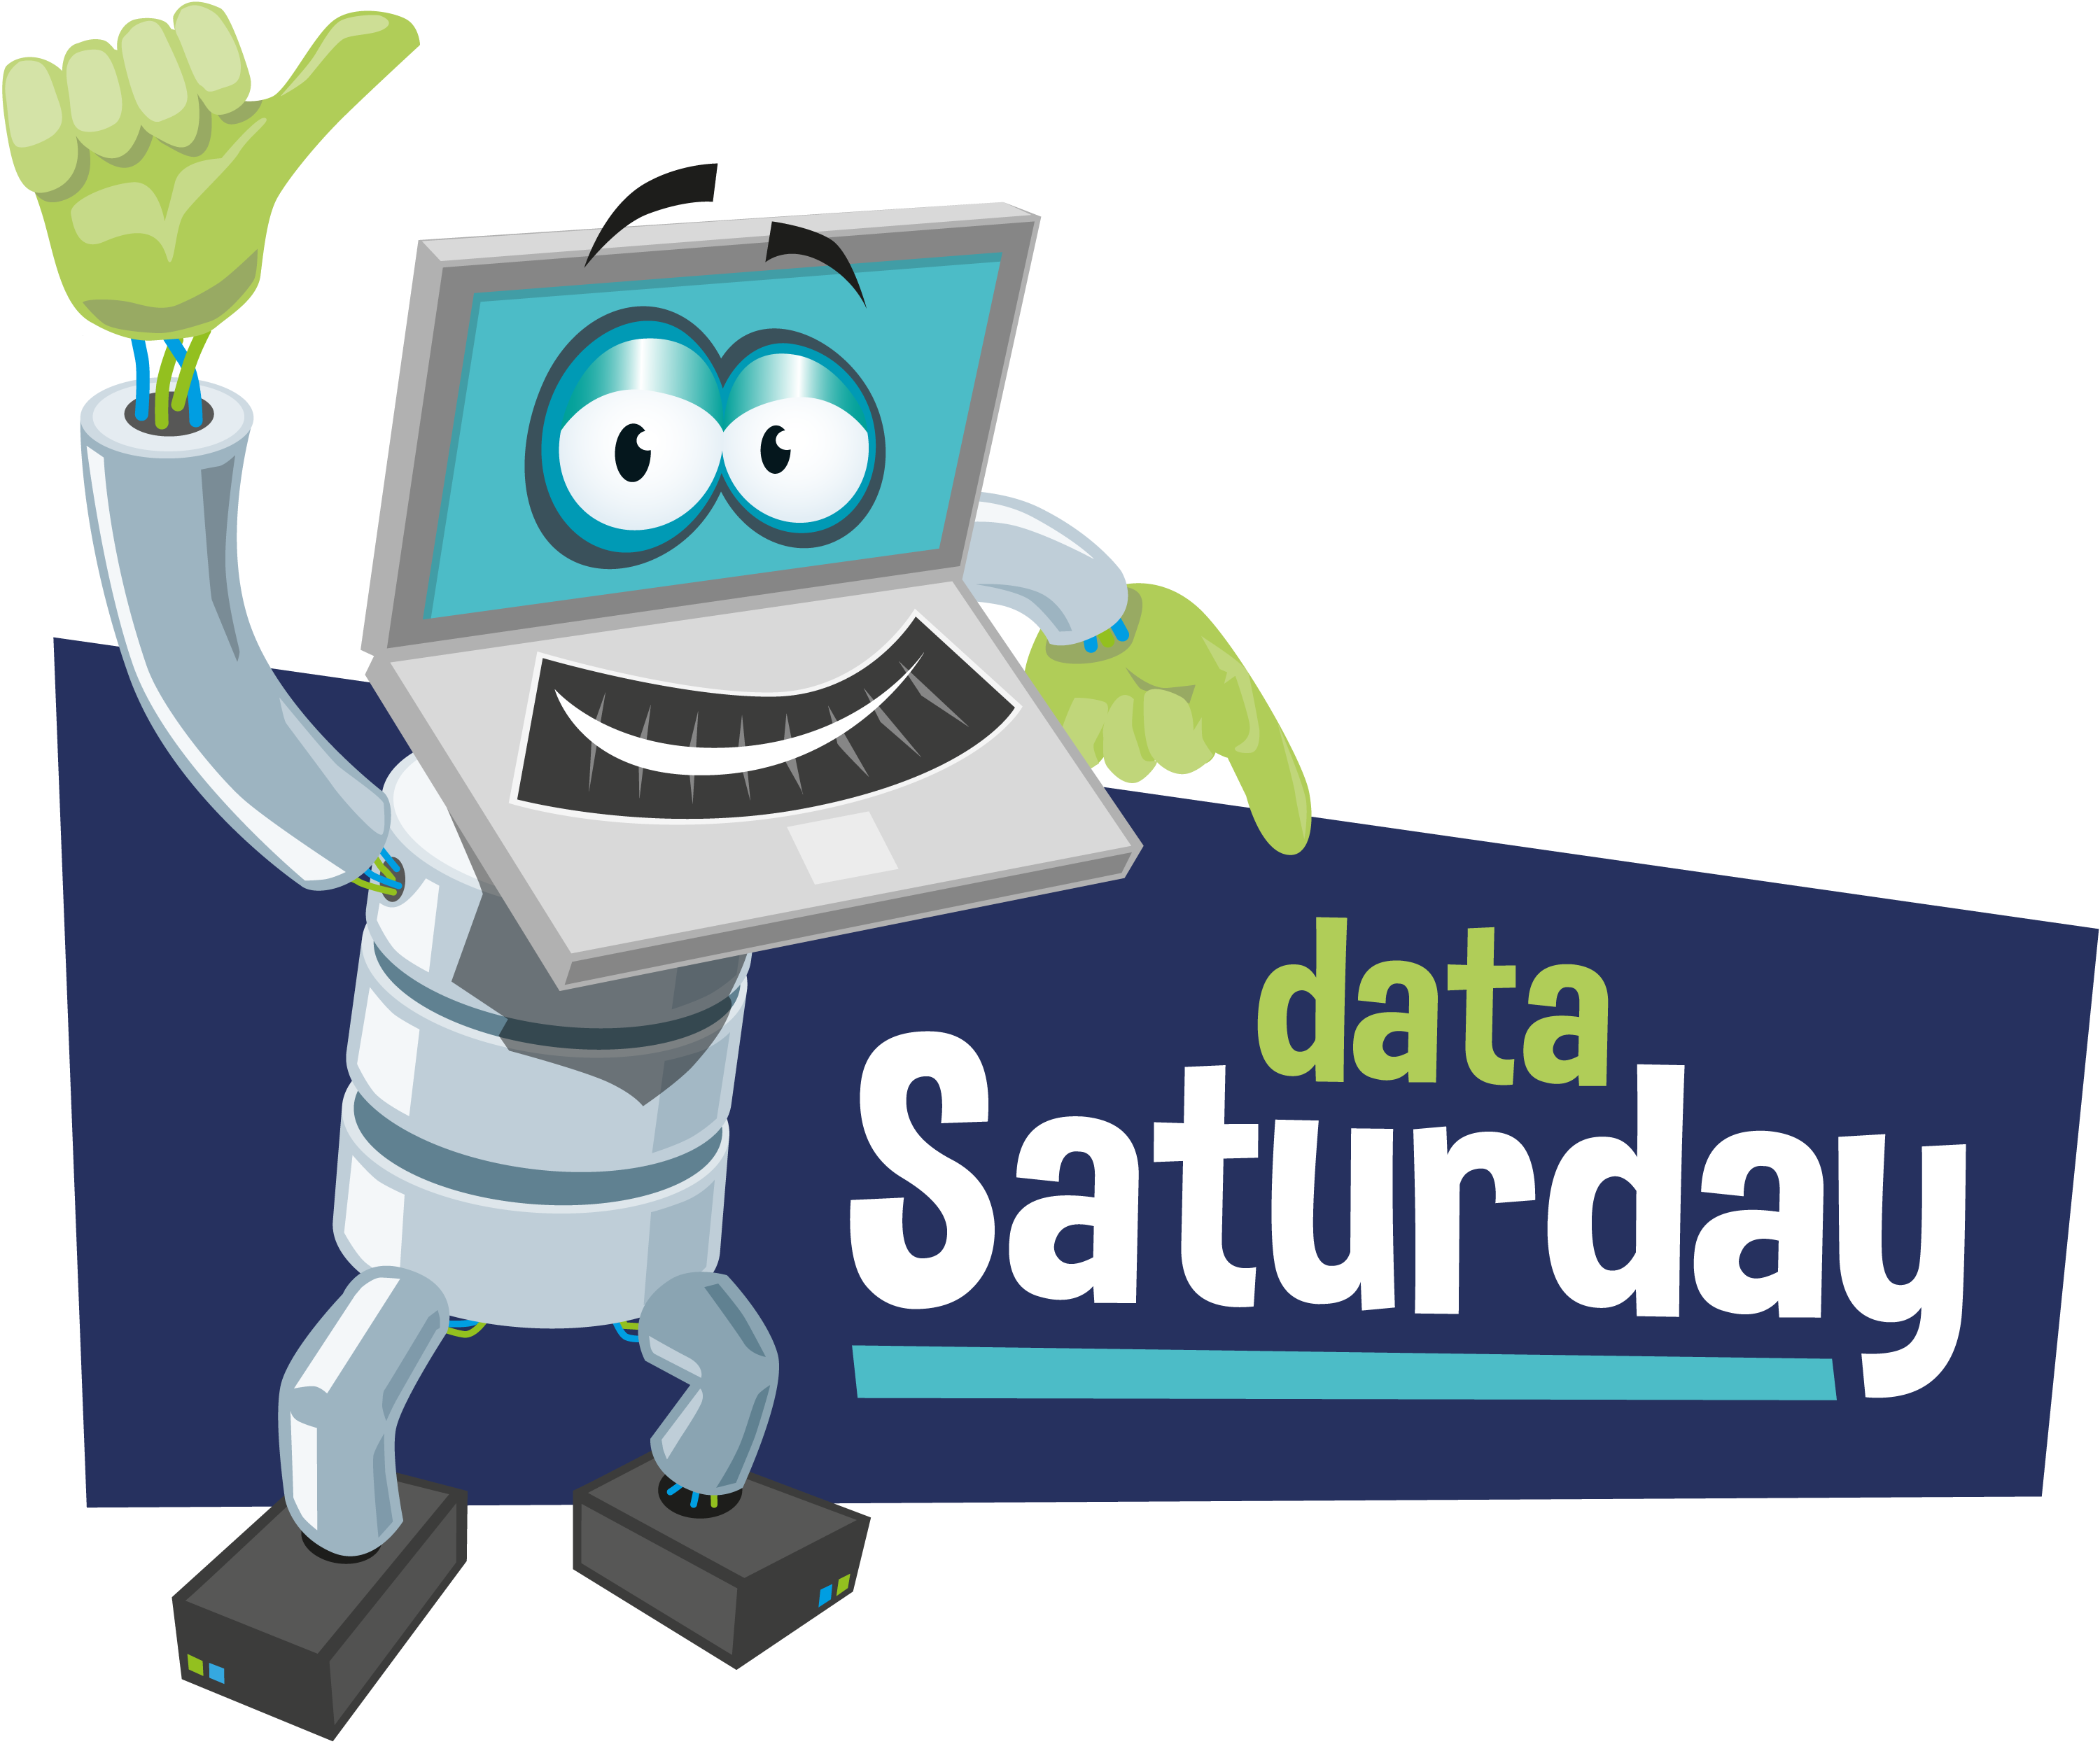









Sponsored by
Notes:
Please add this slide at the beginning of your presentation

Slide 3



Introduction
Enrico van de Laar
Founder | Data & Advanced Analytics consultant @ Dataheroes
Microsoft Data Platform MVP
Author
Speaker
Blogger
Crazy Data Scientist
Twitter: @evdlaar
Email: enrico@dataheroes.nl Web: http://www.enricovandelaar.com

Slide 4


Straight to the point!
Notes:
Big Data Clusters contain all these technologies and can be deployed on-premises or in Azure Kubernetes Services (AKS)

Slide 5
Centralized Data Hub
In essence, the goals of Big Data Clusters is creating a centralized data hub that can store, process and handle data of a wide variety
Data virtualization
Managed SQL Server, Spark, and data lake
Complete AI platform
Analytics
Apps
Admin portal and management services
Integrated AD-based security
T-SQL
REST API containers for models
SQL Server External Tables
SQL Server
Spark
SQL Server
ML Services
Spark & Spark ML
Compute pools and data pools
Scalable, shared storage (HDFS)
Open database connectivity
NoSQL
Relational databases
HDFS
External data sources
HDFS
Combine data from many sources without moving or replicating it
Scale out compute and caching to boost performance
Store high volume data in a data lake and access it easily using either SQL or Spark
Management services, admin portal, and integrated security make it all easy to manage
Easily feed integrated data from many sources to your model training
Ingest and prep data and then train, store, and operationalize your models all in one system
Notes:
Consider many organizations that have separate environments to deal with any of these options BDC provides. BDC brings all of these together into a single solution

Slide 6
Architecture overview

Slide 7
Containers: core of Big Data Clusters
Everything we’ve seen in the previous architecture image runs inside containers!
Containers are a new abstraction level inside the virtualization world
Containers allow for portable and scalable performance without the overhead of virtualization
Notes:
Container images can be persistent in terms of storage etc but also allow the flexibility of statelessness

Slide 8



Container orchestration
Dealing with all the containers we need, and making sure they are running and active, is a complex task that requires an orchestrator
Node
Kubernetes
Master
Node
Node
kubelet
kube-proxy
Node
Pod
Node
Pod
Pod
Node
Node
Notes:
Container(s) live in Pods
Pod(s) are abstractions within Nodes
Node(s) are PC’s or VM’s
Cluster(s) are groups of Nodes
Storage is by means of Volume(s) mounted through a Claim

Slide 9
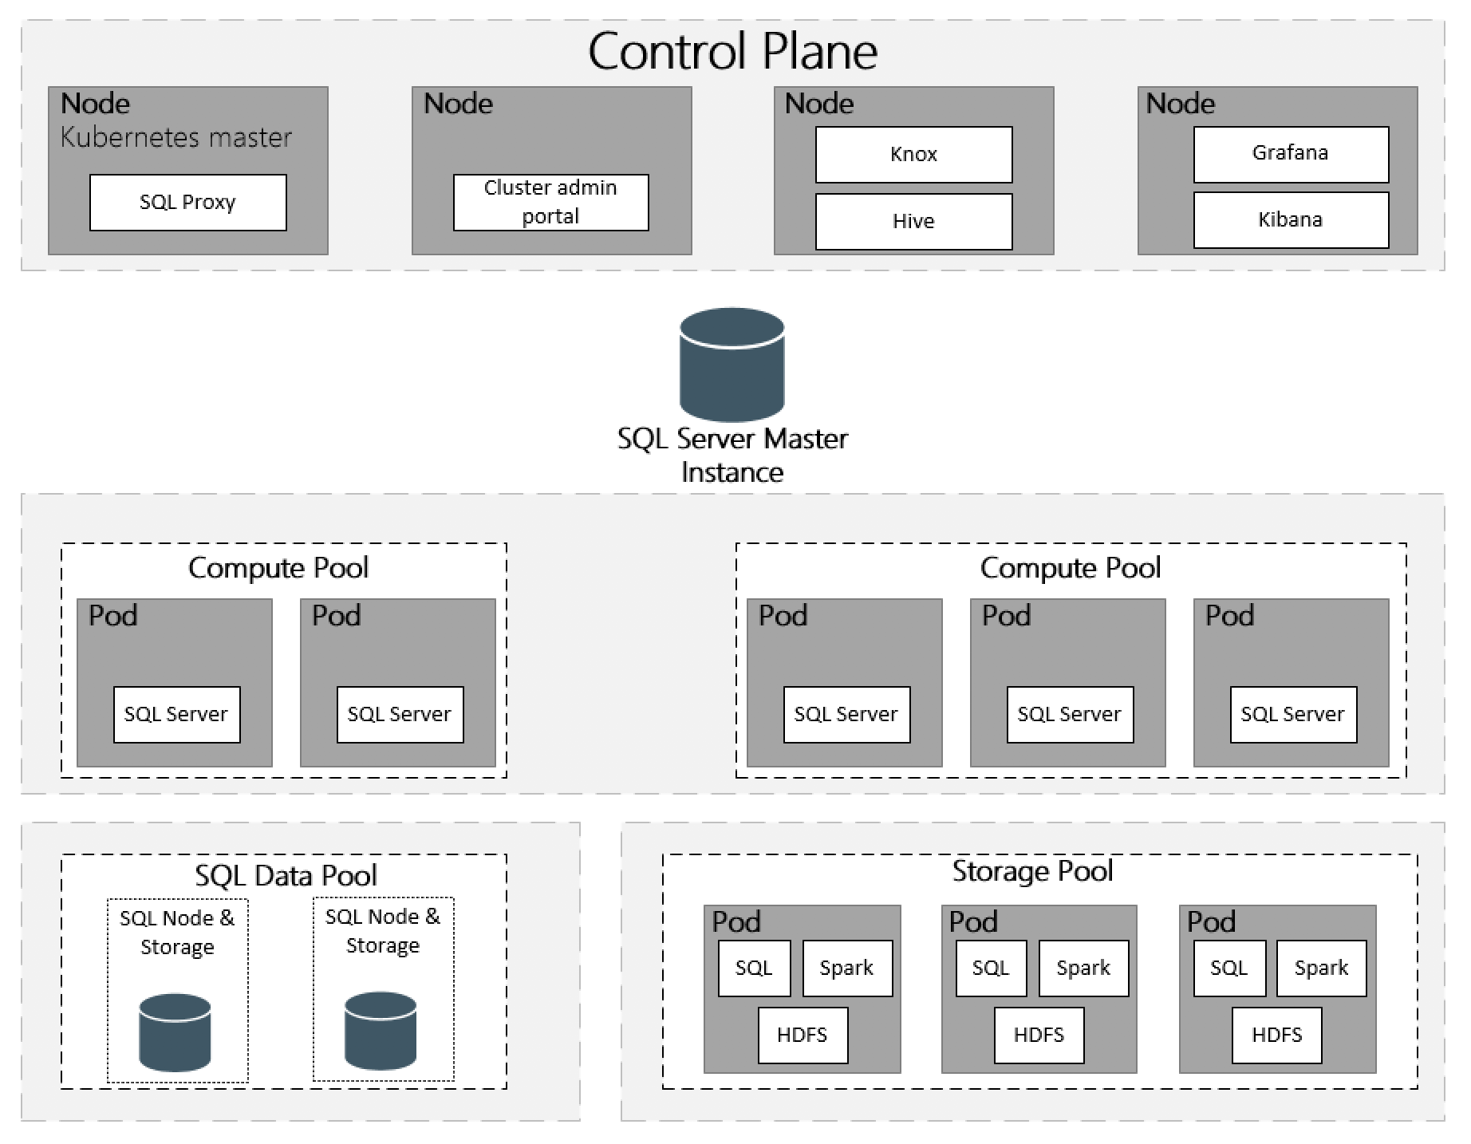
Logical architecture
Notes:
Explain the various pools and areas

Slide 10

Connect and exploring a SQL Server Big Data Cluster
Notes:
Show BDC through Azure Data Studio Show Kibana / Grafana / HDFS etc

Slide 11
Querying external tables
Notes:
Demo create external table from HDFS, use notebooks!

Slide 12
Querying Spark
Notes:
Demo Spark querying on HDFS and SQL database

Slide 13
(optional) Big Data Cluster applications
Notes:
Show how we can build and deploy apps

Slide 14
Questions?
Twitter: @evdlaar
Email: enrico@dataheroes.nl Web: http://www.enricovandelaar.com

Slide 15

Session Evaluation
Notes:
Please add this slide at the end of your presentation

Slide 16

Event Evaluation
Notes:
Please add this slide at the end of your presentation too if you are the last session of the day (16:00 to 16:45)

